Slide 1
CEIS101 Module 5
Adding Distance Sensor to Smart Home System
and Conducting Data Analysis
George Lamboy

Slide 2
Rubric
Activity | Requirement(s) | Points
Set up circuit | Picture of circuit with green LED on | 5
Set up circuit | Picture of circuit with yellow LED on | 5
Set up circuit | Picture of circuit with red LED on | 5
Upload code | Screenshot of code in Arduino IDE with your name shown | 15
Analyze data | Excel plot of data generated by distance sensor | 30

Slide 3
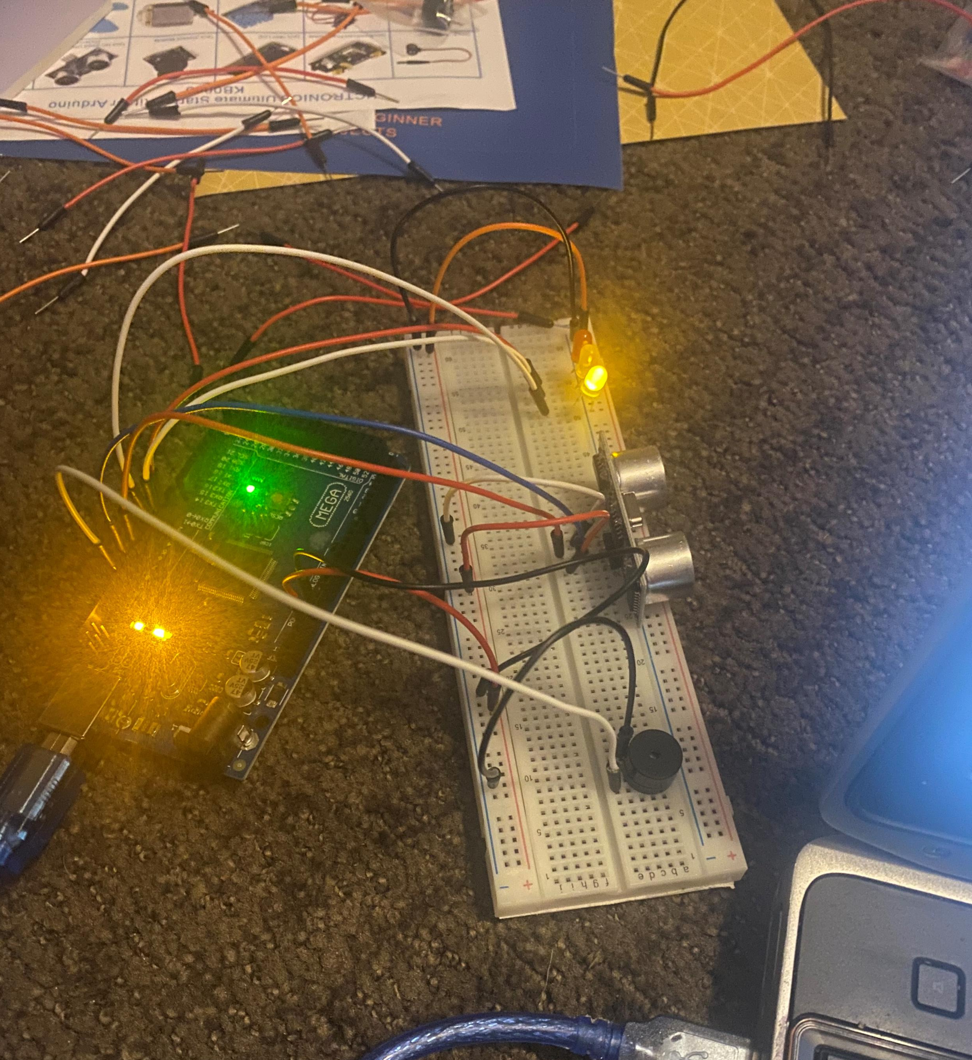
Circuit with green LED on (picture)
Project greenlikght

Slide 4
Circuit with yellow LED on (picture)

Slide 5
Circuit with red LED on (picture)

Slide 6
Arduino Code (screenshot)

Slide 7
Plot of data (graph from Excel)

