Slide 1
Course Project
SEC290
Fundamentals of Infrastructure Security
Module 6 Firewall
George Lamboy

Slide 2
Rubric
Activity | Requirement(s) | Points
Time-based access | Take a screenshot | 20
Dynamic NAT | Take a screenshot | 20
Brute forcing of SSH logins | Take a screenshot | 20

Slide 3
Time-based access
Take a screenshot of the output in Part 1 Step 28.
It should show two time-based access rules in the FORWARD chain.

Slide 4
Dynamic NAT
Take a screenshot of the output in Part 5 Step 3.
It should include prerouting and postrouting rules.

Slide 5
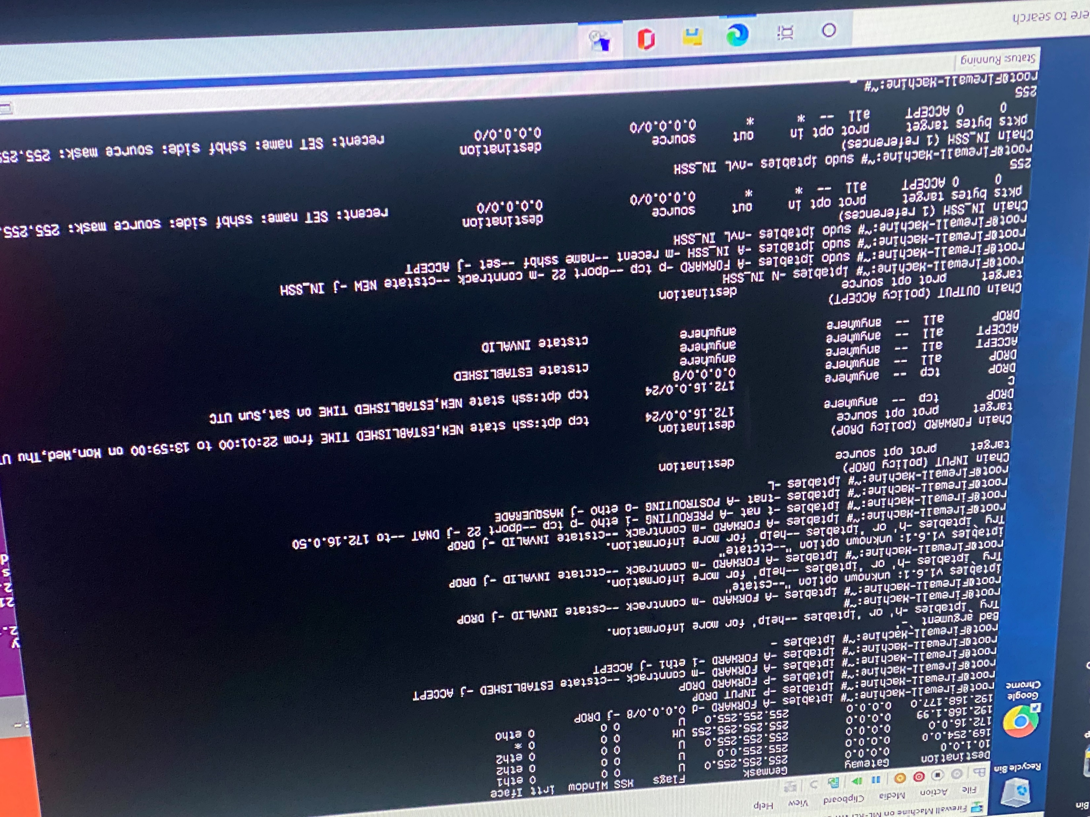
Brute forcing of SSH logins
Take a screenshot of the output in Part 6 Step 7.
It should show the dropped SSH packet count.

