Slide 1
CEIS101 Module 4
Adding Door Sensor to Smart Home System
George Lamboy

Slide 2
Rubric
Activity | Requirement(s) | Points
Set up circuit | Picture of circuit with green LED on (door closed) | 10
Set up circuit | Picture of circuit with red and yellow LEDs on (door open) | 20
Upload code | Screenshot of code in Arduino IDE with your name shown | 10
Run code | Screenshot of serial monitor with your name and messages shown | 20

Slide 3
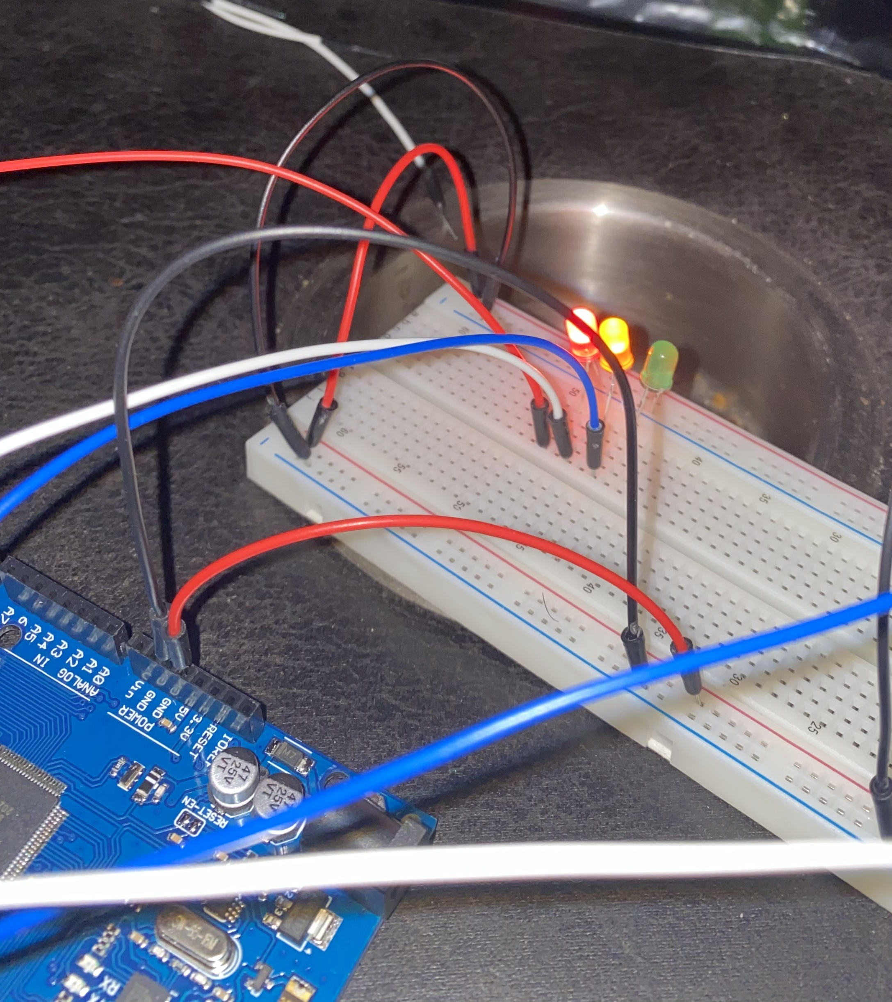
Circuit of door closed with Green LED ON (picture)

Slide 4
Circuit of door open with Green LED OFF (picture)

Slide 5
Arduino Code (screenshot)

Slide 6
Serial Monitor (screenshot)

