Slide 1
NETW211 Course Project
Module 5 Cloud Storage
George Lamboy

Slide 2
Rubric
Activity | Requirement(s) | Points
Question | Answer | 20
Uploading a file | Screenshot | 20
Changing file and bucket permissions | Screenshot | 20

Slide 3
Question
What does the default encryption do?
Answer here:With Amazon S3 default encryption, you can set the default encryption behavior for an S3 bucket so that all new objects are encrypted when they are stored in the bucket. The objects are encrypted using server-side encryption with either Amazon S3-managed keys (SSE-S3) or AWS KMS keys stored in AWS Key Management Service (AWS KMS) (SSE-KMS).
When you configure your bucket to use default encryption with SSE-KMS, you can also enable S3 Bucket Keys to decrease request traffic from Amazon S3 to AWS Key Management Service (AWS KMS) and reduce the cost of encryption. For more information, see Reducing the cost of SSE-KMS with Amazon S3 Bucket Keys.
When you use server-side encryption, Amazon S3 encrypts an object before saving it to disk and decrypts it when you download the objects. For more information about protecting data using server-side encryption and encryption key management, see Protecting data using server-side encryption.
For more information about permissions required for default encryption, see PutBucketEncryption in the Amazon Simple Storage Service API Reference.
To set up default encryption on a bucket, you can use the Amazon S3 console, AWS CLI, AWS SDKs, or the REST API. For more information, see Enabling Amazon S3 default bucket encryption.
Encrypting existing objects
To encrypt your existing Amazon S3 objects, you can use Amazon S3 Batch Operations. You provide S3 Batch Operations with a list of objects to operate on, and Batch Operations calls the respective API to perform the specified operation. You can use the Batch Operations Copy operation to copy existing unencrypted objects and write them back to the same bucket as encrypted objects. A single Batch Operations job can perform the specified operation on billions of objects. For more information, see Performing large-scale batch operations on Amazon S3 objects and the AWS Storage Blog post Encrypting objects with Amazon S3 Batch Operations.
You can also encrypt existing objects using the Copy Object API. For more information, see the AWS Storage Blog post Encrypting existing Amazon S3 objects with the AWS CLI
References:
1. Setting default server-side encryption behavior for Amazon S3 buckets - Amazon Simple Storage Service
2.
Setting default server-side encryption behavior for Amazon S3 buckets

Slide 4
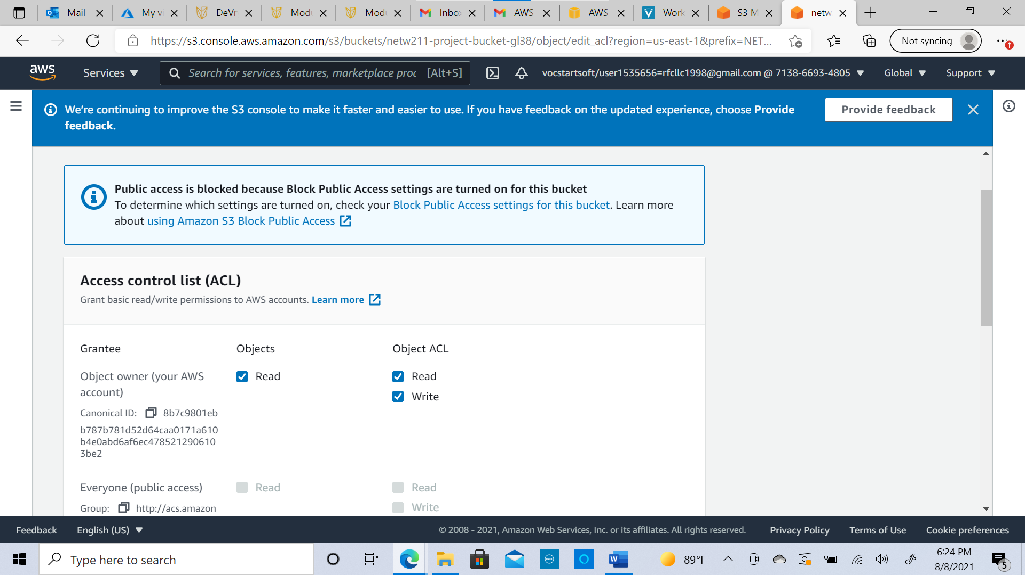
This screenshot should show the Access Denied error message in a browser window.
Uploading a file

Slide 5
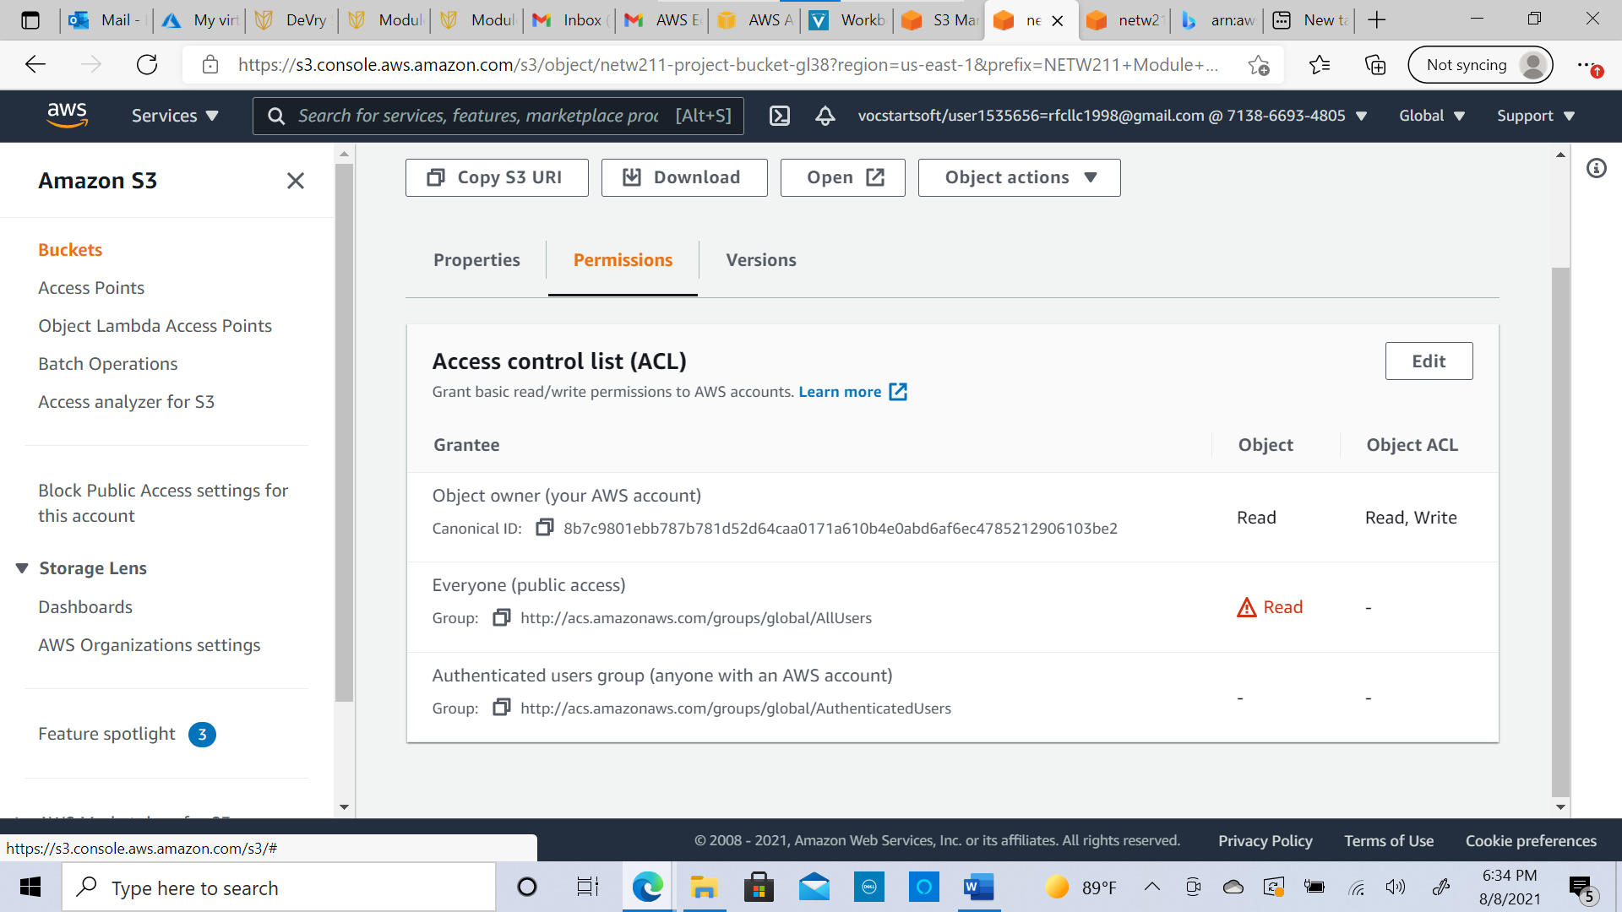
Changing permissions
This screenshot should show the permissions or access control list (ACL) information of the uploaded file.

