Slide 1
CEIS101 Module 6
Adding Automated Light to Smart Home System
George Lamboy

Slide 2
Rubric
Activity | Requirement(s) | Points
Set up circuit | Picture of complete circuit with automated LED off | 10
Set up circuit | Picture of complete circuit with automated LED on | 20
Upload code | Screenshot of code in Arduino IDE with your name shown | 10
Run code | Screenshot of Serial Monitor with your name and messages shown | 20

Slide 3
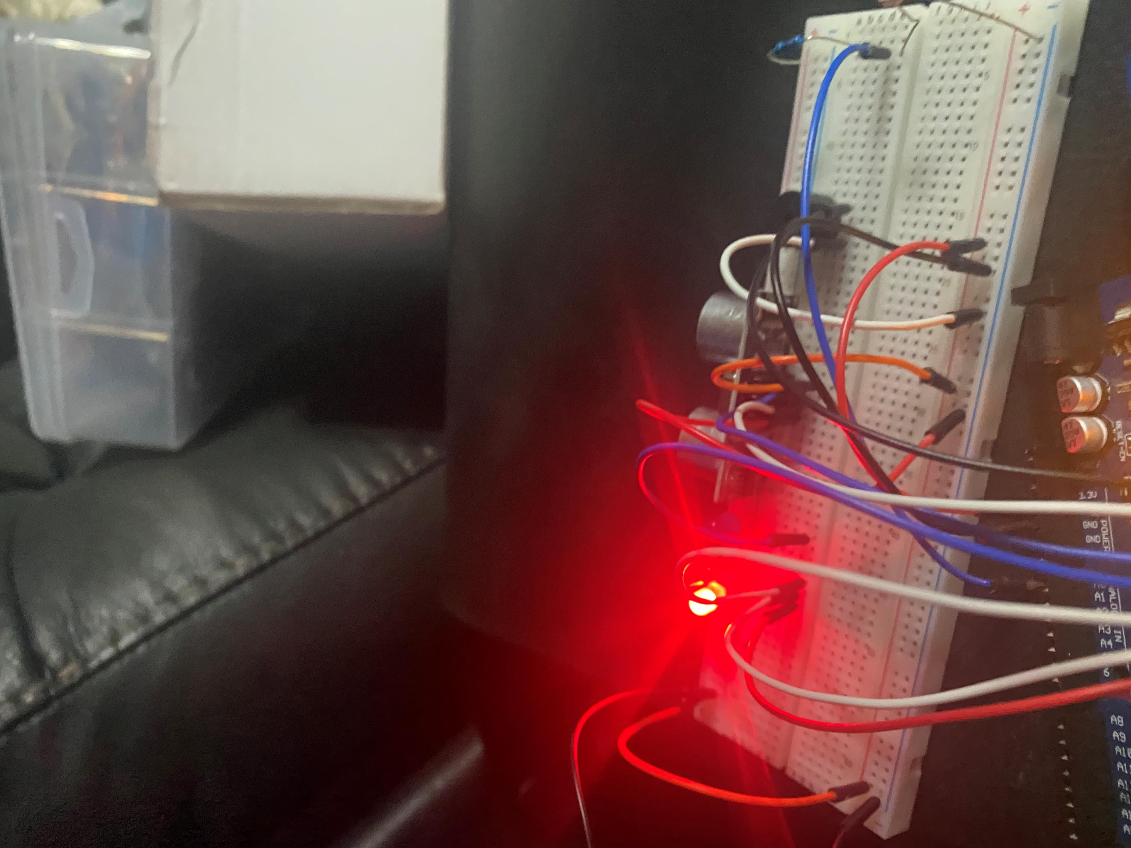
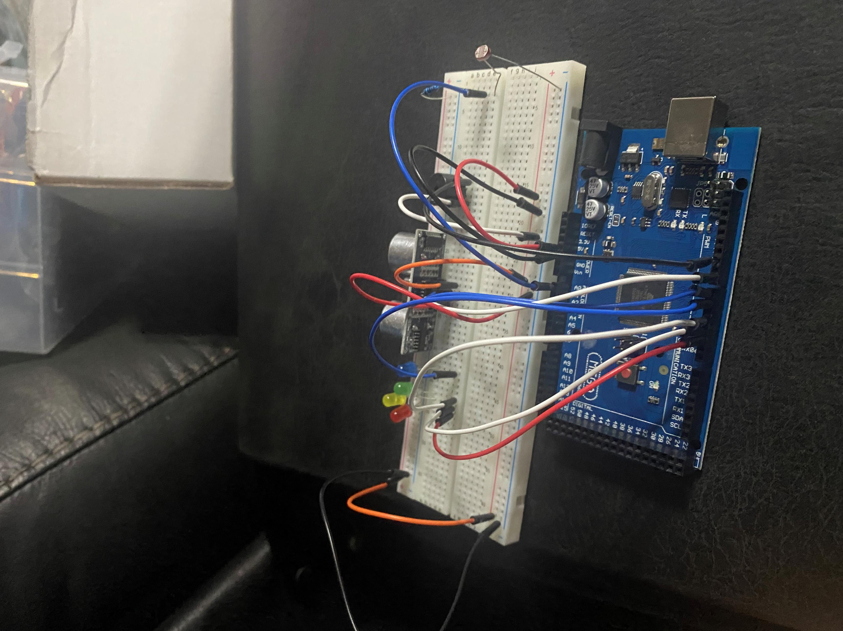
Circuit with automated LED off (picture)

Slide 4
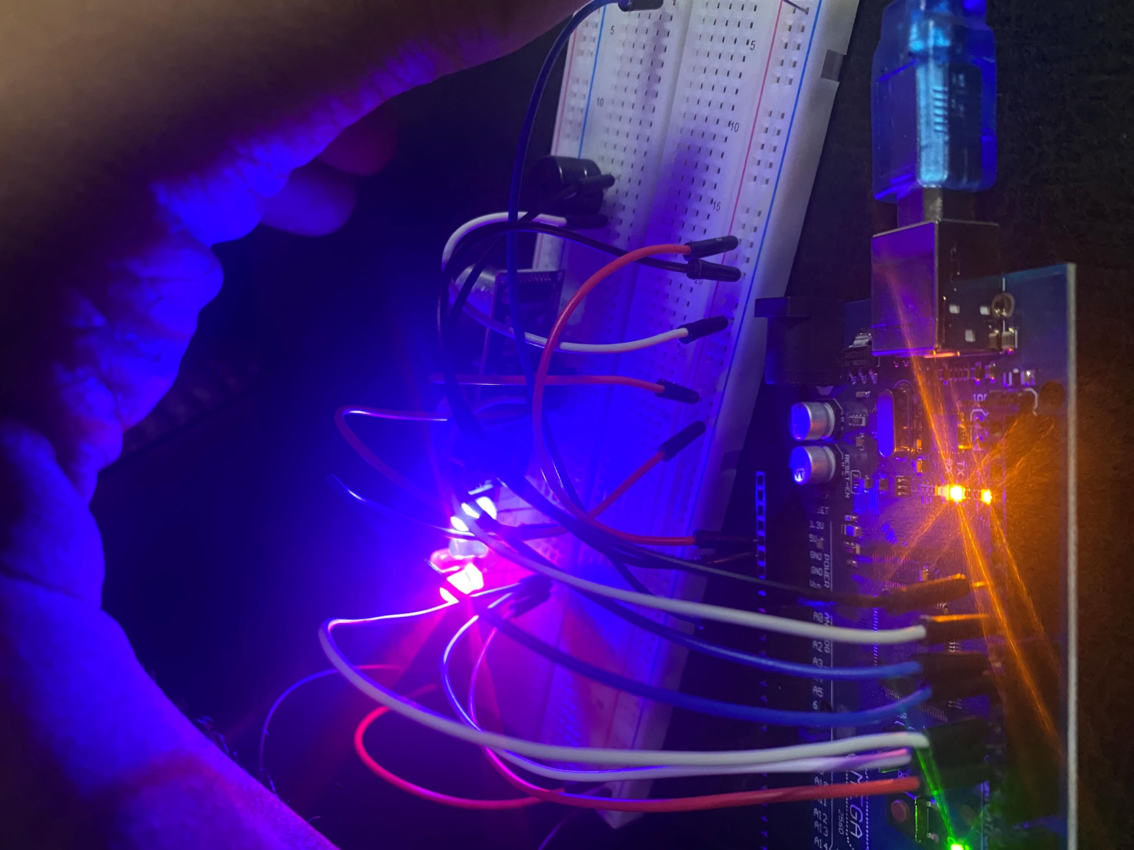
Circuit with automated LED on (picture)

Slide 5
Arduino Code (screenshot)

Slide 6
Serial Monitor (screenshot)

