Slide 1
SEC285
Module 3
Stateful Firewall
George Lamboy

Slide 2
Rubric
Activity | Requirement(s) | Points
Question | Answer | 30
Nmap Scan | Screenshot | 30

Slide 3
Question
What effect does the sudo iptables --policy INPUT DROP command have on the access to computing resources?
Answer here: sudo iptables -P INPUT DROP The ‘ -P ‘ indicates that we will be making a change to the overall policy, ‘ INPUT ‘ is the chain to edit, and ‘ DROP ‘ is the default policy target.
References:

Slide 4
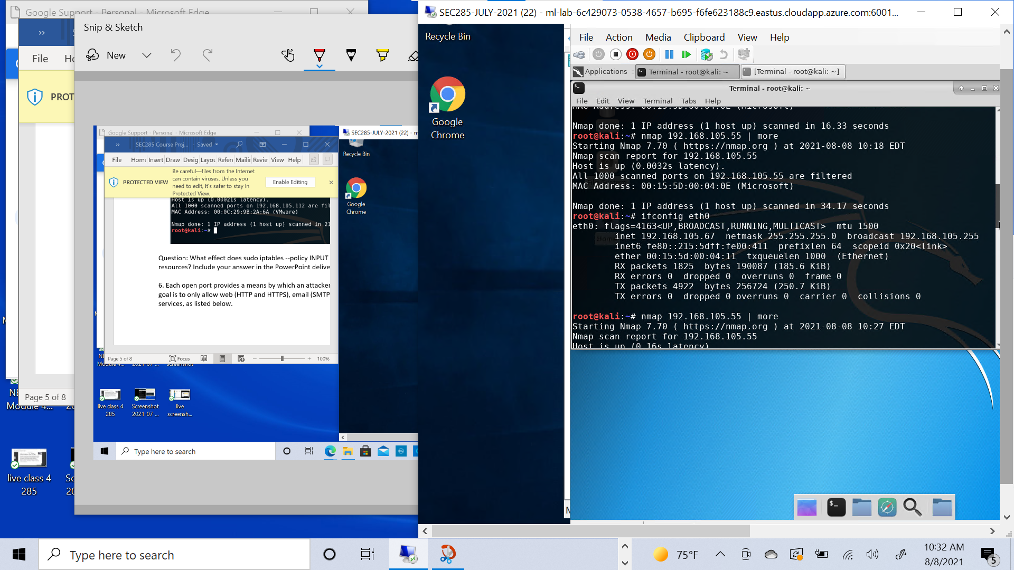
Nmap Scan
This screenshot should show the Nmap scan result of the Linux Server VM.

